Slide 1
Hashing
Chapter 10
2nd Ed Pages 620 – 638
3rd Ed pages 622 - 637
BSc in Software Development
Computer Science 1 2008/9
Notes:
BSc in Software Development - Year 2
Computer Science 1
Hashing

Slide 2
Hash Searching
Linear Search O(N)
Binary Search O(Log₂ N)
? Search O(1)
=>
A search that has a constant time no matter where the element is in the list
BSc in Software Development
Computer Science 1 2008/9

Slide 3
Possible:
List of employees in a fairly small company
Each of the 100 employees has an Employee ID number in the range 0 to 99
To retrieve an employees information, go to the appropriate array element based on the Employee ID
Problem:
This idea works for small amounts of data but it does not expand to a larger searching problem, e.g. 5 digit numbers
Now the key values range from 00000 to 99999 => 100,000 element array.
BSc in Software Development
Computer Science 1 2008/9

Slide 4
Why is this a Problem:
Obviously it is impractical to set up an array of 100,000 elements just to store the information about 100 employees, so as to achieve O(1) search, so that each employees information is stored in a perfectly unique and predictable location.
To keep the array size down to an array of 100 elements, just use the last 2 digits of the key (Employee ID)
For example: Employee 53374 is stored in employeeList.info[74]
Employee 81235 is stored in employeeList.info[35]
BSc in Software Development
Computer Science 1 2008/9

Slide 5
Note:
The elements are not stored according to the value of the key.
Instead, the elements are stored with respect to some function of the key value.
This function is called a Hash Function and the search technique is called Hashing
In the example the Hash Function is key%100.
This simple function transforms the key value into an index value.
BSc in Software Development
Computer Science 1 2008/9

Slide 6
int ExType::Hash() const
//Post: Function value is an integer between 0 // and MAX_ITEMS-1
{
return (idNum % MAX_ITEMS);
}
Assume that Hash() is a member function of ExType, the type of the items stored in the Hash table. idNum is a private data member of ExType.
Example of an ExType Class:
BSc in Software Development
Computer Science 1 2008/9

Slide 7
exType.h
//exType.h defines the item saved sorted and searched in the Hash table.
#ifndef EXTYPE
#define EXTYPE
#include<iostream.h>
const int MAX_ITEMS = 11;
class ExType{
private:
int idNum;
public:
ExType();
ExType(int);
int Hash()const;
BSc in Software Development
Computer Science 1 2008/9

Slide 8
friend istream& operator>>(istream &is, ExType &item);
friend ostream& operator<<(ostream &os, ExType item);
bool operator==(const ExType& item) const;
bool operator!=(const ExType& item) const;
~ExType();
};
#endif
BSc in Software Development
Computer Science 1 2008/9

Slide 9
exType.cpp
//exType.cpp - implementation of exType.h, where functionality of ExType obj's are defined
#include“exType.h"
ExType::ExType()
{
idNum=0;
}
ExType::ExType(int id)
{
idNum=id;
}
BSc in Software Development
Computer Science 1 2008/9

Slide 10
istream& operator>>(istream &is, ExType &item)
{
is>>item.idNum;
return is;
}
ostream& operator<<(ostream &os, ExType item)
{
os<<item.idNum;
return os;
}
BSc in Software Development
Computer Science 1 2008/9

Slide 11
bool ExType::operator==(const ExType& item) const
{
if(idNum == item.idNum)
return true;
else
return false;
}
bool ExType::operator!=(const ExType& item) const
{
if(idNum != item.idNum)
return true;
else
return false;
}
BSc in Software Development
Computer Science 1 2008/9

Slide 12
ExType::~ExType()
{
}
int ExType::Hash() const
//Post: Function value is an integer between 0 // and MAX_ITEMS-1
{
return (idNum % MAX_ITEMS);
}
BSc in Software Development
Computer Science 1 2008/9

Slide 13
Definitions:
Hash Function: A function used to manipulate the key of an element in a list to identify its location in the list.
Hashing: the technique used for ordering and accessing elements in a list in a relatively constant amount of time by manipulating the key to identify its location in the list.
The Hash Function is used as a method of accessing the list element.
It tells us where to look for a particular element
This information is needed to retrieve, modify or delete an element.
BSc in Software Development
Computer Science 1 2008/9

Slide 14
First Attempt at RetrieveItem():
template<class ItemType>
void HashType<ItemType>::RetrieveItem(ItemType& item, bool& found)
// Post: item is a copy of the element in the // array at position item.Hash()
{
int location;
location = item.Hash();
item = info[location];
}
BSc in Software Development
Computer Science 1 2008/9

Slide 15
The Hash Function also determines where in the array to store the element:
First Attempt at InsertItem():
template<class ItemType>
void ListType<ItemType>::InsertItem(ItemType item)
// Post: item is stored in the array at position // item.Hash()or the next free spot.
{
int location;
location = item.Hash();
info[location] = item;
length++;
}
BSc in Software Development
Computer Science 1 2008/9

Slide 16
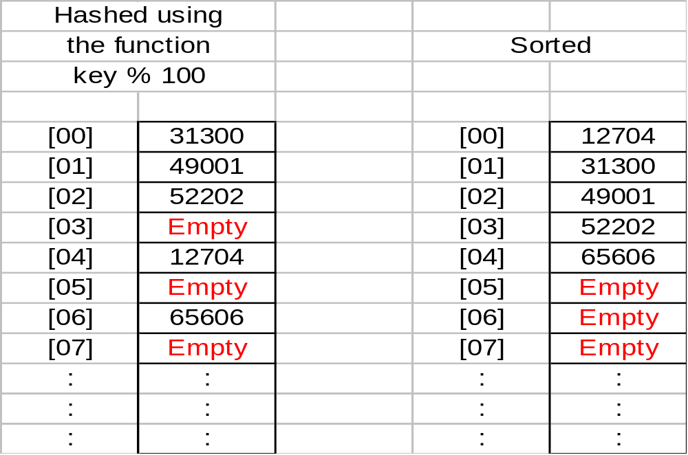
Example:
Records for employees with key values (unique ID numbers)
12704 31300 49001 52202 65606
BSc in Software Development
Computer Science 1 2008/9

Slide 17
Note:
Hashing:
Array elements are not filled sequentially.
There are empty elements between occupied elements.
The same Hash Function must be used for storing and retrieving / modifying / deleting.
BSc in Software Development
Computer Science 1 2008/9

Slide 18
Collisions:
  This scheme does not guarantee unique hash locations.
  ID number 01234 and ID number 91234 both hash to the same location
    list.info[34]
  The problem of avoiding collisions is the biggest challenge in designing a good Hash Function.
  A good Hash Function minimizes collisions by spreading the elements uniformly throughout the array.
BSc in Software Development
Computer Science 1 2008/9

Slide 19
Definition:
Collision: The condition resulting when two or more keys produce the same hash location.
Problem:
  How are collisions resolved?
  Where do you store the elements that cause them?
Several different collision handling algorithms e.g.
  Open addressing and Linear Probing
  Open addressing and Quadratic Probing
BSc in Software Development
Computer Science 1 2008/9

Slide 20
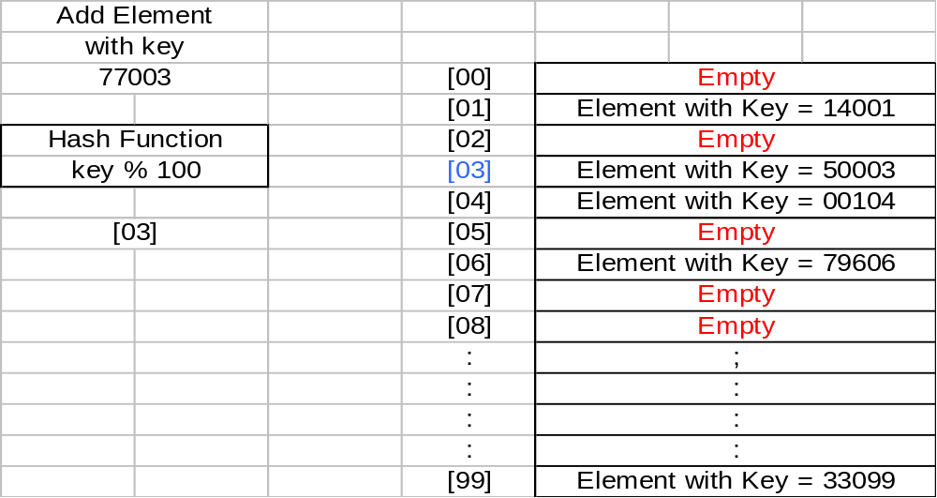
Linear Probing:
Simple Approach – store the colliding element into the next available space
This location [03] is occupied, as is location [04] but location [05] is empty, so store the element with key = 77003 in location [05]
BSc in Software Development
Computer Science 1 2008/9

Slide 21
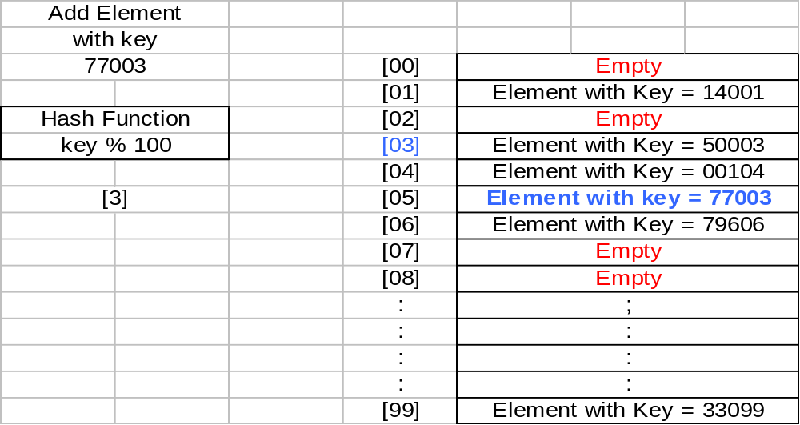
Element with key = 77003 is stored in location [05]
BSc in Software Development
Computer Science 1 2008/9

Slide 22
Definition:
Linear Probing: Resolving a hash collision by sequentially
searching a hash table beginning at the location returned by
the Hash Function.
BSc in Software Development
Computer Science 1 2008/9

Slide 23
Note 1:
The array is treated as a circular structure so that if a key hashes to the last array index and that space is in use, we continue looking for an empty location at the beginning of the array.
=> Use the % operator when the index is incremented:
location = (location + 1) % MAX_ITEMS
BSc in Software Development
Computer Science 1 2008/9

Slide 24
Note 2:
We need to be able to recognize that a location is empty
=> each array location needs to be initialized to a special emptyItem value.
This value (a parameter to the class constructor) must be syntactically legal but semantically illegal.
BSc in Software Development
Computer Science 1 2008/9

Slide 25
2nd Attempt at InsertItem():
template<class ItemType> void ListType<ItemType>::InsertItem(ItemType item)
// Post: item is stored in the array at position
// item.Hash() or the next free spot.
{
int location;
location = item.Hash();
while (info[location] != emptyItem)
location = (location + 1) % MAX_ITEMS;
info[location] = item;
length++;
}
BSc in Software Development
Computer Science 1 2008/9

Slide 26
RetrieveItem():
template<class ItemType> void ListType<ItemType>::RetrieveItem( ItemType& item, bool& found)
{
int location;
int startLoc;
bool moreToSearch = true;
startLoc = item.Hash();
location = startLoc;
BSc in Software Development
Computer Science 1 2008/9

Slide 27
  do
{
if (info[location] == item || info[location] == emptyItem)
moreToSearch = false;
else
location = (location + 1) % MAX_ITEMS;
} while(location != startLoc && moreToSearch);
found = (info[location] == item);
if ( found)
item = info[location];
}
BSc in Software Development
Computer Science 1 2008/9

Slide 28
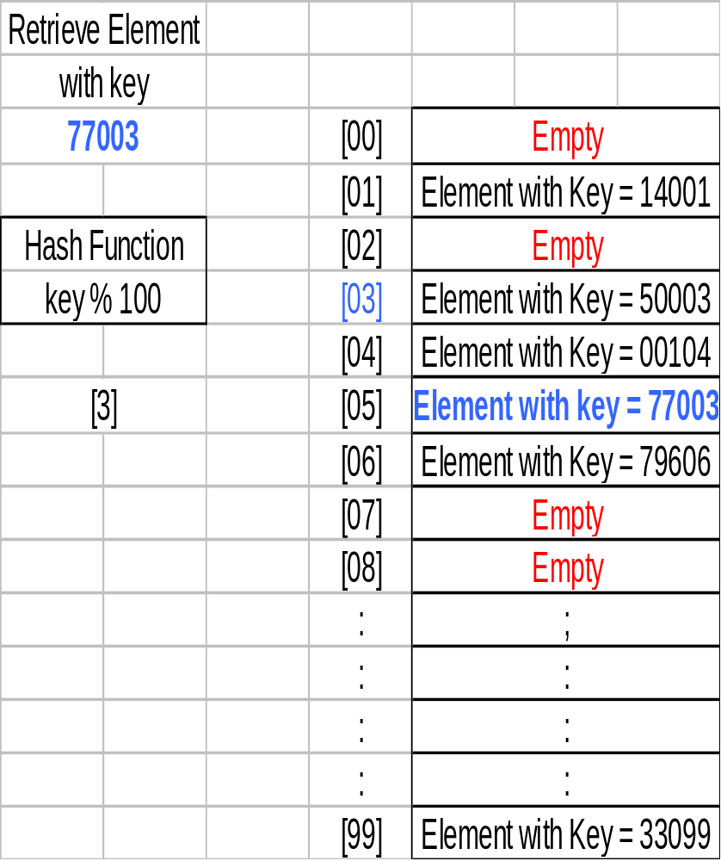
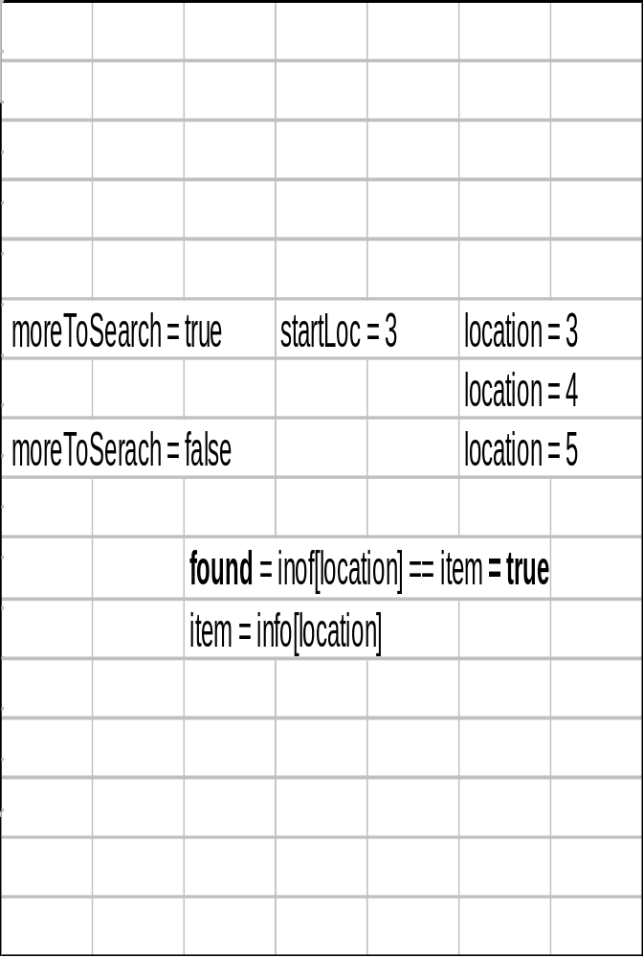
RetrieveItem() Example (found):
BSc in Software Development
Computer Science 1 2008/9

Slide 29
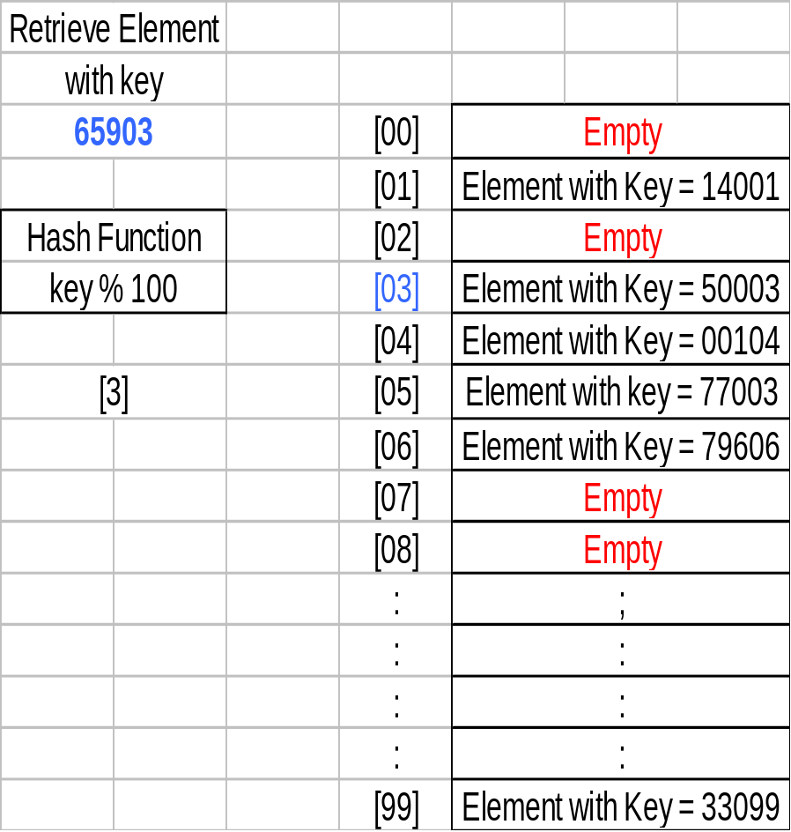
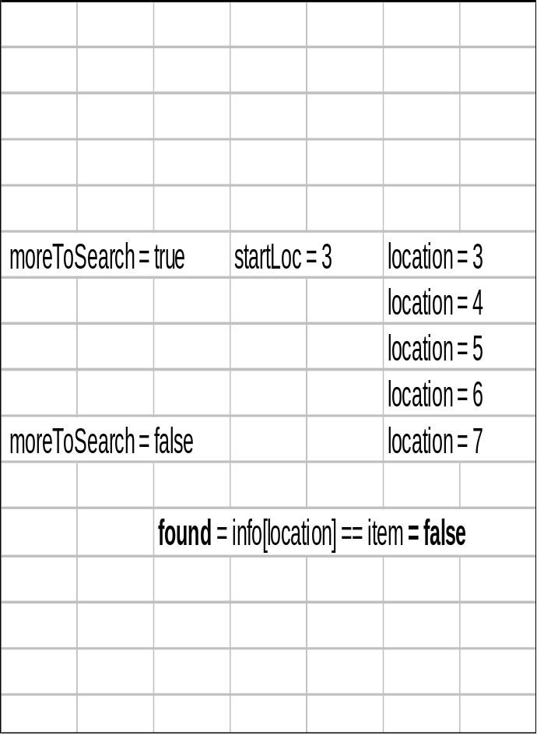
RetrieveItem() Example (not found):
BSc in Software Development
Computer Science 1 2008/9

Slide 30
Deleting from a Hash Table:
Simple approach
set location to item.Hash()
set info[location] to emptyItem
Collisions however complicate the matter.
InsertItem() inserts an item at the hash location or linearly searches forward to find the first empty location.
RetrieveItem() terminates the search on finding the item or on encountering an empty location (found = false).
If DeleteItem() “empties” the slot occupied by a deleted element, we may terminate a subsequent search prematurely.
BSc in Software Development
Computer Science 1 2008/9

Slide 31
Example:
Insert the following keys into a hash table in the order given:
14001 00104 50003 77003 42504 33099
Delete
77003
Retrieve
42504
BSc in Software Development
Computer Science 1 2008/9

Slide 32
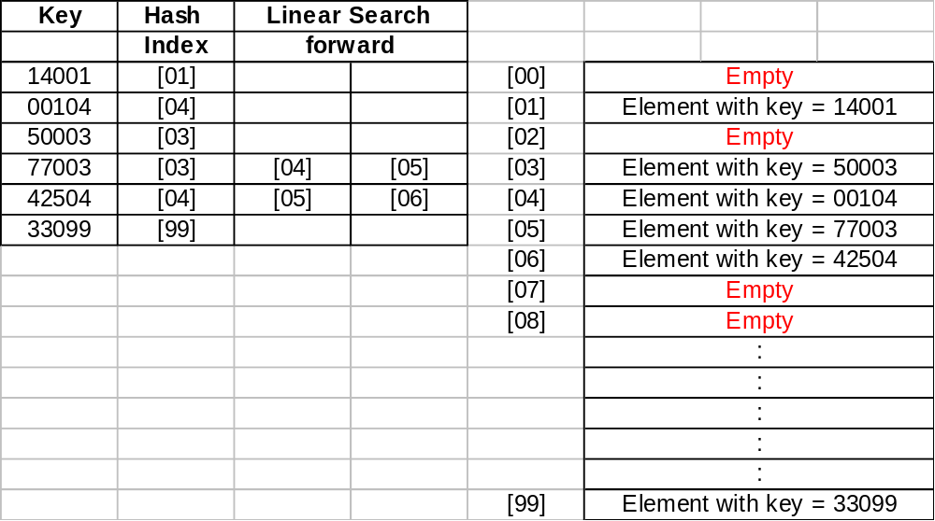
Insert the following keys into a hash table in the order given:
14001 00104 50003 77003 42504 33099
BSc in Software Development
Computer Science 1 2008/9

Slide 33
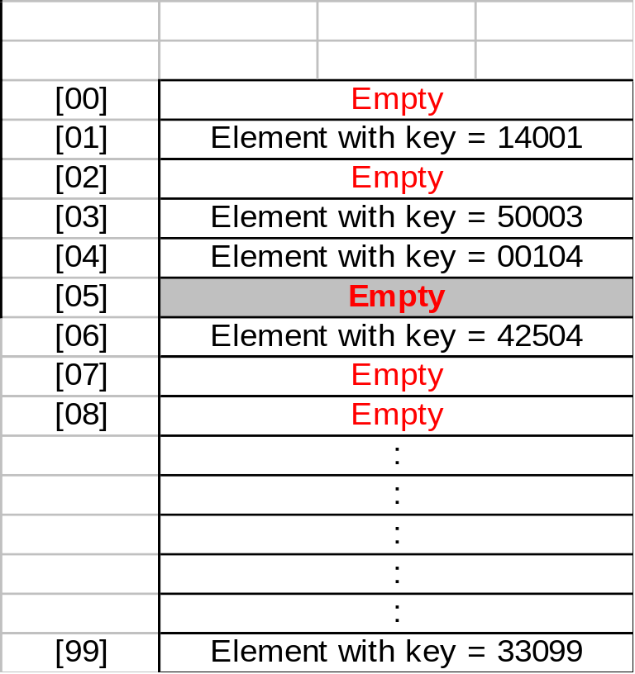
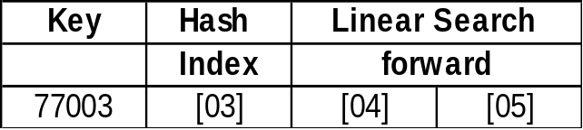
Delete 77003
  The element with key 77003 is stored in location [05]
  Set location [05] back to emptyItem
BSc in Software Development
Computer Science 1 2008/9

Slide 34
Retrieve 42504
  The element with key 42504 is stored at location [06]
  First hash to location [04]
  location [04] does not contain an element with key 42504, so linear search forward to check location [05]
  location [05] contains emptyItem. The search is therefore terminated with found = false
But there is an element with key 42504 stored at location [06] which will not be found.
Why???
BSc in Software Development
Computer Science 1 2008/9

Slide 35
The problem arises because location [05] was occupied when 42505 was inserted into the hash table causing it to be stored at location [06]
Subsequently, a delete occurred which set location [05] to emptyItem.
This is now terminating the search.
Solution
Create another constant value deletedItem, to use in slots that were occupied by deleted records.
BSc in Software Development
Computer Science 1 2008/9

Slide 36
How will deletedItem work?
A location containing deletedItem means that
  it is currently free for an element to be inserted.
  but was previously occupied so do not terminate a search at this location.
=> InsertItem() must be modified to treat locations with deletedItem and emptyItem the same:
  the search for an available location for the new element ends
=> RetrieveItem() remains the same:
  only emptyItem halts the search, deleteItem does not.
BSc in Software Development
Computer Science 1 2008/9

Slide 37
Final Version InsertItem() with Linear probing:
template<class ItemType> void ListType<ItemType>::InsertItem(ItemType item)
// Post: item is stored in the array at position // item.Hash() or the next free spot.
{
int location;
location = item.Hash();
while (info[location] != emptyItem && info[location] != deletedItem)
location = (location + 1) % MAX_ITEMS;
info[location] = item;
length++;
}
BSc in Software Development
Computer Science 1 2008/9

Slide 38
Final Version RetrieveItem() with Linear probing:
template<class ItemType> void ListType<ItemType>::RetrieveItem(ItemType& item, bool& found)
{
int location;
int startLoc;
bool moreToSearch = true;
startLoc = item.Hash();
location = startLoc;
BSc in Software Development
Computer Science 1 2008/9

Slide 39
do
{
if (info[location] == item || info[location] == emptyItem)
moreToSearch = false;
else
location = (location + 1) % MAX_ITEMS;
} while(location != startLoc && moreToSearch);
found = (info[location] == item);
if ( found)
item = info[location];
}
BSc in Software Development
Computer Science 1 2008/9

Slide 40
Note:
After many deletions, the search “path” to an element may travel through many array locations with deletedItem.
This may cause the efficiency of retrieving an element to deteriorate.
Therefore in the above form, hash tables are not the most effective data structure for implementing lists whose elements may be deleted.
BSc in Software Development
Computer Science 1 2008/9

Slide 41
Problem with resolving collisions using Linear Probing:
Clustering occurs with Linear Probing
Definition:
Clustering: The tendency of elements to become unevenly distributed in the hash table, with many elements grouping together around a single hash location.
A good hash function results in a uniform distribution of the elements throughout the array’s index range, with the probability of each location being filled equal to 1/MAX_ITEMS.
BSc in Software Development
Computer Science 1 2008/9

Slide 42
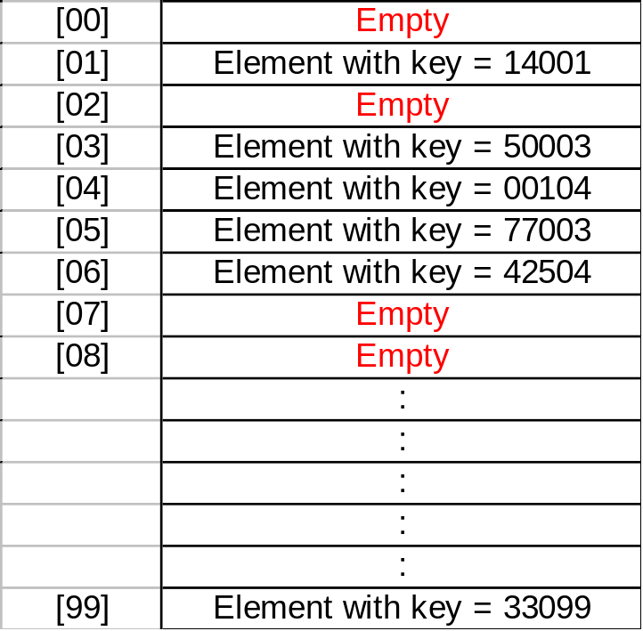
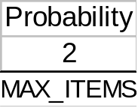


After a number of collisions have been resolved, the distribution of elements in the array becomes less and less uniform.
The records tend to cluster (or group) together as multiple keys begin to compete for a single hash location.
BSc in Software Development
Computer Science 1 2008/9

Slide 43
Therefore array location [07] is five times as likely as array location [08] to be filled.
Clustering results in inconsistent efficiency of insertion and retrieval operations.
When this happens, rather than having an efficient search where most of the elements are retrieved with one comparison, the hash search begins to deteriorate into a linear search.
Ways other then linear probing need to be looked at in order to reduce clustering when resolving collisions.
BSc in Software Development
Computer Science 1 2008/9

Slide 44
Definition:
Rehashing: Resolving a collision by computing a new hash location from a hash function that manipulates the original location rather than the element’s key.
Linear probing is an example of collision resolution by rehashing.
1 is added to the hash value to create a new hash value. That is we used the rehash function (hash value + 1) % 100.
BSc in Software Development
Computer Science 1 2008/9

Slide 45
Deciding on the size of the hash table:
In our examples we have used 100 as the hash table size and this implied the following hash function
key % 100.
This is because it is easy to work with from the examples point of view.
Research has shown however that best choice of number is a prime number rather than 100.
A prime number in general gives a better spread of the keys within the index range.
BSc in Software Development
Computer Science 1 2008/9

Slide 46
So rather than using 100 as the hash table size, use a prime number close to 100.
Also increasing the hash table size by about 20% reduces the number of collisions.
So if a hash table is required to store 100 elements, then allow for 120 elements.
But 120 is not a prime number so choose an appropriate prime number around 120, for example 127
This implies that the table will always contain empty locations. This improves the hash search along with the fact that the spread of keys within the hash table is better.
BSc in Software Development
Computer Science 1 2008/9

Slide 47
Definition:
Quadratic Probing: Resolving a hash collision by using the rehashing function
(hash value + i²) % table size
where i is the number of times that the rehash function has been applied.
Quadratic Probing reduces clustering, but only examines half the hash table elements if the hash table size is a prime number.
BSc in Software Development
Computer Science 1 2008/9

Slide 48
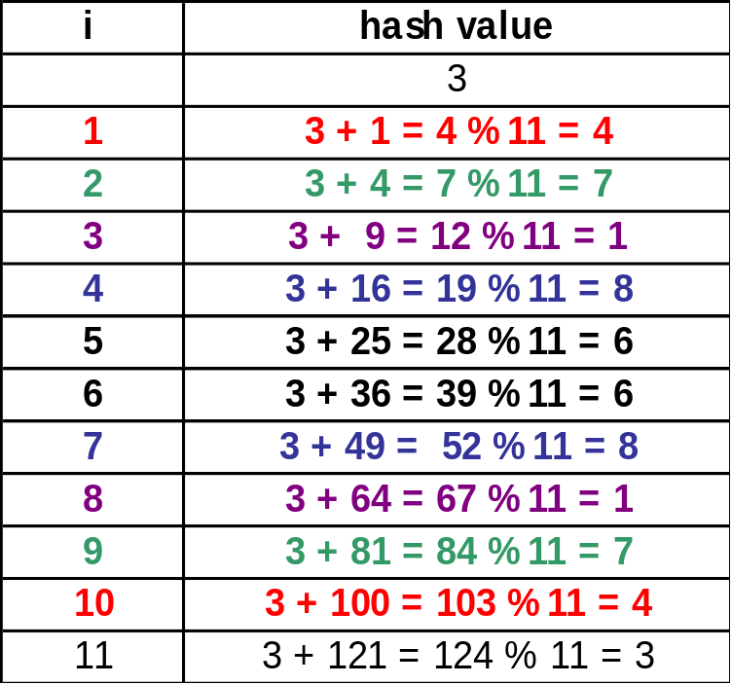
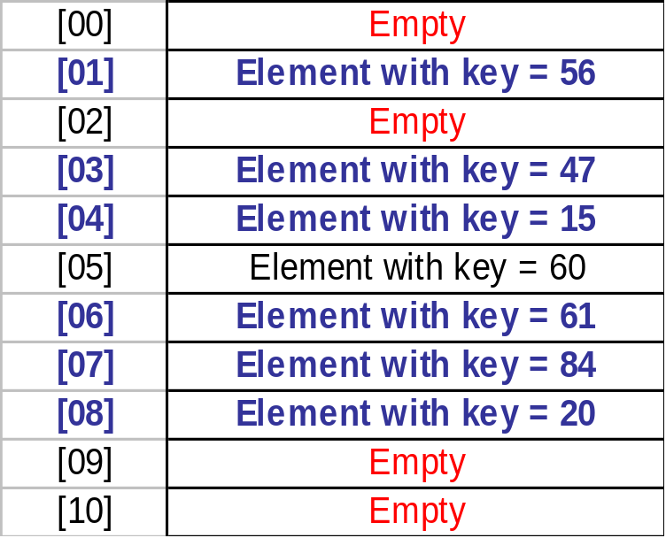
Quadratic Probing Example:
Suppose that we wish to insert an element with
  key = 36 into a
  hash table of size 11 ( a prime number).
=> the hash value is 3.
BSc in Software Development
Computer Science 1 2008/9

Slide 49
Note :
Only half the array elements are checked.
The book makes the following statement:
  “if the array-size is a prime number of the form (4*some-integer + 3), quadratic probing does examine every slot in the array.”
This is incorrect. Should read “does not examine every slot in the array.”
As we can see from the previous example, 11 = (4 * 2 + 3) and only half of the array elements are checked.
Once half of the locations have been checked, there is no point continuing => a check: pc < (MAX_ITEMS + 1)/2 with pc initialized to 1 and incremented each time a location is checked: pc++.
BSc in Software Development
Computer Science 1 2008/9

Slide 50
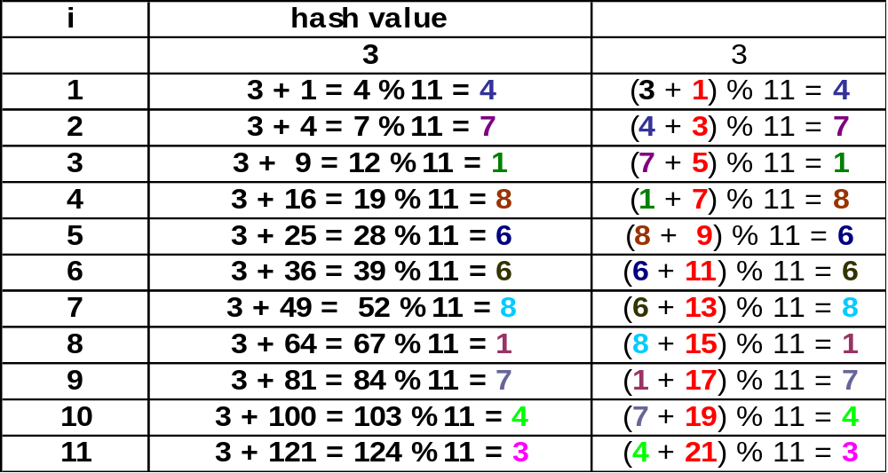
Quadratic probing is implemented using addition rather than multiplication.
increment=1; location = item.Hash();
location = (location + increment) % MAX_ITEMS;
increment += 2;
BSc in Software Development
Computer Science 1 2008/9

Slide 51
Implementing Quadratic Probing:
template <class ItemType>
void HashType<ItemType>::InsertItem(ItemType item)
{
int location, increment=1, pc=1;
location = item.Hash();
BSc in Software Development
Computer Science 1 2008/9

Slide 52
while ((info[location] != emptyItem &&
info[location] != deletedItem) &&
(info[location] != item) &&
(pc < (MAX_ITEMS+1)/2))
{
location = (location + increment) % MAX_ITEMS;
increment += 2;
pc++;
}
BSc in Software Development
Computer Science 1 2008/9

Slide 53
if (info[location] == emptyItem ||
info[location] == deletedItem)
info[location] = item;
else if (info[location] == item)
cout << "\nERROR: InsertItem: Duplicate Key";
else
cout << "\nERROR: InsertItem: HashTable Full QP";
}
BSc in Software Development
Computer Science 1 2008/9

Slide 54
RetrieveItem() where the element has been added using Quadratic Probing can be implemented in a similar fashion.
template <class ItemType>
void HashType<ItemType>::RetrieveItem(
ItemType &item, bool &found)
{
int location, increment=1, pc=1;
location = item.Hash();
BSc in Software Development
Computer Science 1 2008/9

Slide 55
while ((info[location] != emptyItem) &&
(info[location] != item) &&
(pc < (MAX_ITEMS+1)/2))
{
location = (location + increment) % MAX_ITEMS;
increment += 2;
pc++;
}
BSc in Software Development
Computer Science 1 2008/9

Slide 56
if (info[location] == item)
{
found = true;
item = info[location];
}
else
found = false;
}
BSc in Software Development
Computer Science 1 2008/9

Slide 57
Definition:
Random Probing: Resolving a hash collision by generating pseudo-random hash values in successive applications of the rehash function.
Pseudo-random number generator determine the increment to the hash value in each application of the rehash function.
Excellent for eliminating clustering, but tends to be slower than other techniques discussed.
BSc in Software Development
Computer Science 1 2008/9

Slide 58
Definition:
Bucket: A collection of elements associated with a particular hash location
Another approach to collision resolution
Allow multiple keys to hash to the same location
The computed hash location contains slots for multiple elements, rather than just a single element.
Each of these multi-element locations is called a bucket
BSc in Software Development
Computer Science 1 2008/9

Slide 59
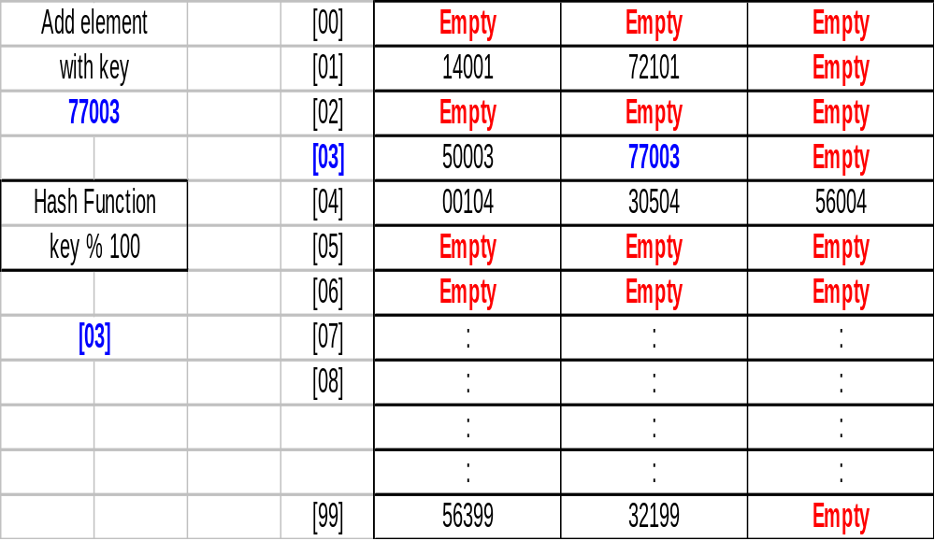
This allows collision resolution up to a point.
When a bucket becomes full, we must again deal with handling collisions.
BSc in Software Development
Computer Science 1 2008/9

Slide 60
Other hash Methods:
How can we use hashing if the element key is a string instead of an integer?
use the internal representations (ASCII code) of the string’s characters to create a number that can be used as an index.
Example
the key is a 5 element character array, a string, and the hash function produces a hash value in the range 0 through to MAX_ITEMS –1
BSc in Software Development
Computer Science 1 2008/9

Slide 61
int ItemType::Hash()const
{
int sum = 0;
for ( int i = 0; i < MAX; i++)
sum = sum + int(id[i]);
return sum % MAX_ITEMS;
}
BSc in Software Development
Computer Science 1 2008/9

Slide 62
Folding:
Folding is a hash function that breaks the key into several pieces and concatenates or exclusive-ors some of them to form the hash value.
Devise a hash function that results in an index between 0 and 255 and the internal representation of the key is a 32-bit bit string
We know that it takes 8 bits to represent the index range (2⁸ = 256 => 0 to 255)
A folding algorithm to create a hash function might be:
BSc in Software Development
Computer Science 1 2008/9

Slide 63
Example of a Folding Algorithm:
Break the key into 4 bit strings of 8-bits each
Exclusive-or the first and last strings
Exclusive-or the middle bit strings, and
Exclusive-or the results of steps 2 and 3 to produce the 8-bit index into the array.
BSc in Software Development
Computer Science 1 2008/9

Slide 64
Key 618403
Binary 00000000 00001001 01101111 10100011
1. 1st 2nd 3rd 4th
2. 0000 0000 3. 0000 1001 4. 1010 0011 1010 0011 0110 1111 0110 0110 1010 0011 0110 0110 1100 0101
Binary 1100 0101 = 128 + 64 + 4 + 1 = 197
So key 618403 hashes to location 197 in the hash table.
BSc in Software Development
Computer Science 1 2008/9
Notes:
BSc in Software Development - Year 2
Computer Science 1
Hashing

Slide 65
Note on Exotic Hash Functions:
Consider the efficiency of calculating the function.
Even if it produces unique values, it is not a good hash function if it takes longer to calculate the hash value than to search half the list.
Consider programmer time
An extremely exotic function that produces unique hash values for all known key values may fail if the domain of possible key values changes in a later modification.
A perfect hash function is possible if all the keys are known in advance, but in general a perfect hash function requires a great deal of effort. Usually its computational complexity is very high.
BSc in Software Development
Computer Science 1 2008/9

Slide 66
Analyzing Hashing:
A precise analysis of the complexity of hashing is beyond the scope of this course.
Our aim was to find a list implementation in which the insert, retrieve and delete operations were O(1)
If our hash function never produces duplicates or if the array size is very large compared to the expected number of items in the list, then we have succeeded.
As the number of elements approaches the array-size, the efficiency of the algorithms deteriorates.
BSc in Software Development
Computer Science 1 2008/9

Slide 67
Collision Resolution by Chaining
BSc in Software Development
Computer Science 1 2008/9

Slide 68
Definition:
Chain: A linked list of elements that share the same location.
The hash value is not the actual location of the element
It is an index into an array of pointers.
Each pointer accesses a chain of elements that share the same hash location.
Rather than rehashing, elements share the same hash location
The entry in the array at this location contains a pointer to a linked list that includes all the elements that hash to that location.
BSc in Software Development
Computer Science 1 2008/9

Slide 69
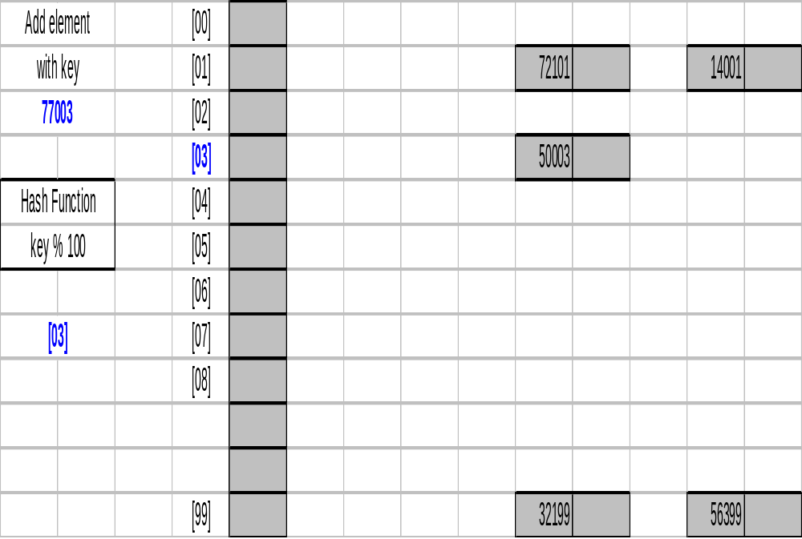
Before Inserting element with key = 77003:
BSc in Software Development
Computer Science 1 2008/9

Slide 70
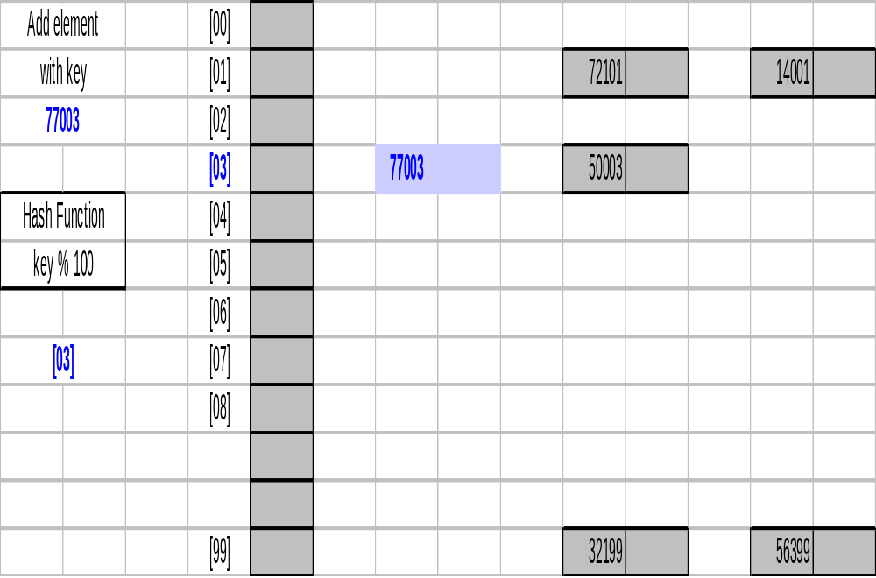
After Inserting element with key = 77003:
BSc in Software Development
Computer Science 1 2008/9

Slide 71
To search, first apply the hash function to the key, then search the chain for the element
Searching the chain is still a linear search, but is limited to elements that actually share a hash location.
With linear probing, you may have to search through many additional elements if the slots following the hash location are filled with elements from collisions on other hash locations.
For example, insert the following keys, in the order given, into a hash table with open addressing and linear probing and insert then into a chained hash table:
45300 20006 50002 40000 25001 13000 65905 30001 95000
Note: Chained hash table different from the book.
BSc in Software Development
Computer Science 1 2008/9

Slide 72
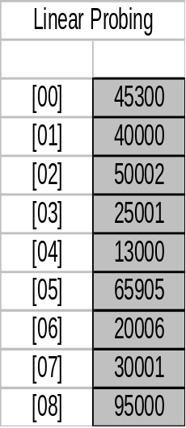
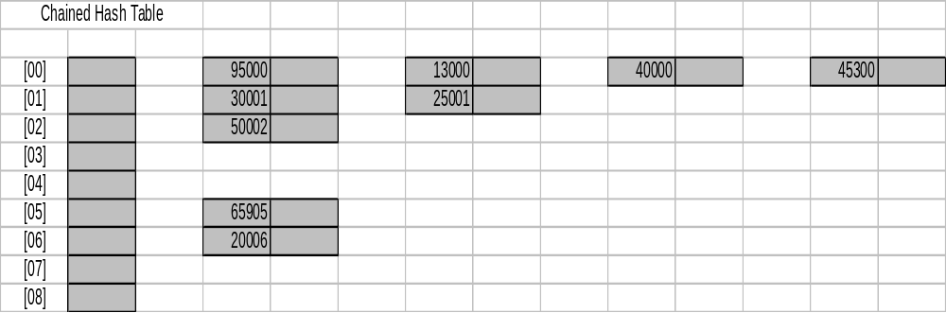
Linear Probing:
45300 20006 50002 40000 25001 13000 65905 30001 95000
Chained Hash Table:
BSc in Software Development
Computer Science 1 2008/9

Slide 73
Search for the element with key 30001
Hash value = 1
Linear Probing
  linear search forward to find it in location 7
  7 comparisons required
Chained Hash Table
search the linked list out from index 1. 30001 is found at the beginning of the list
1 comparison required.
BSc in Software Development
Computer Science 1 2008/9

Slide 74
Linear Probing:
45300 20006 50002 40000 25001 13000 65905 30001 95000
7 comparisons required
Chained Hash Table:
1 comparison required
BSc in Software Development
Computer Science 1 2008/9

Slide 75
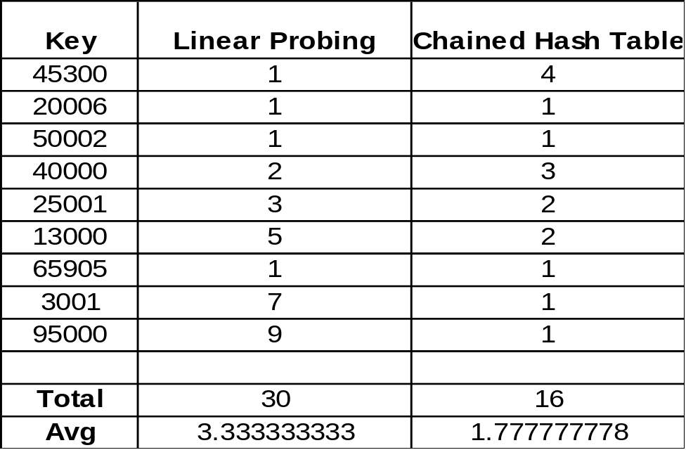
In general, the average number of comparisons required to retrieve an element corresponding to any key in the tables should be considered when deciding which method of collision resolution is better.
Obviously, The chained hash table in this case is better, 1.8 comparisons v 3.3 comparisons.
BSc in Software Development
Computer Science 1 2008/9

Slide 76
Another Advantage of Chained over Open Addressing:
Deletion is simplified:
  Apply the hash function to obtain the array index that contains the pointer to the appropriate chain.
  The node can be deleted from this chain using the linked list deletion algorithm.
BSc in Software Development
Computer Science 1 2008/9

Slide 77
Choosing a Good Hash Function:
To minimize collisions, increase the array size in order to increase the range of hash function.
Selecting the table size => a space vs time trade off
  the larger the range of hash locations (the table size), the less likely it is that 2 keys hash to the same location (fewer collisions => faster search)
  However allocating an array that contains a large number of empty slots wastes space
  O(1) No collision
  O(N) if collisions cause very disproportionate chains (clustering)
We should also know something about the key value.
BSc in Software Development
Computer Science 1 2008/9

Slide 78
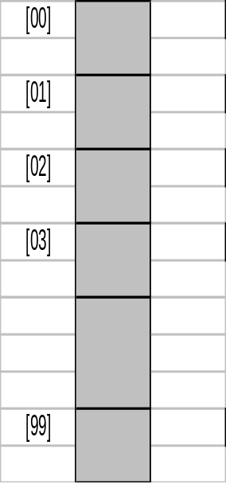
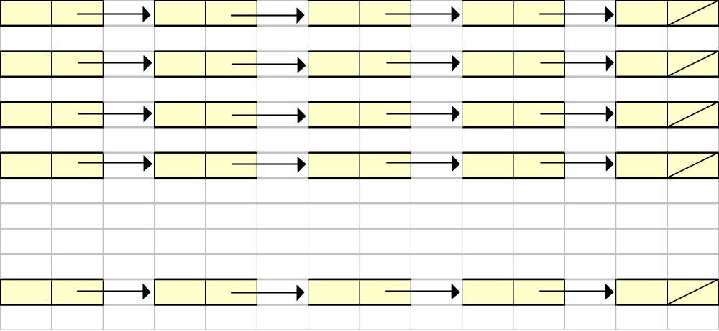
Example:
500 Employee records, stored according to company id which is 6 digits long
Decide to use a chained approach to handling collisions
100 chains (expecting an average of 5 elements per chain)
hash function idnum % 100
BSc in Software Development
Computer Science 1 2008/9

Slide 79
The Plan:
Average 5 records/chain
5 records x 100 chains = 500 employees
Expected search O(5)
Average number of comparisons/search = 3
BSc in Software Development
Computer Science 1 2008/9

Slide 80
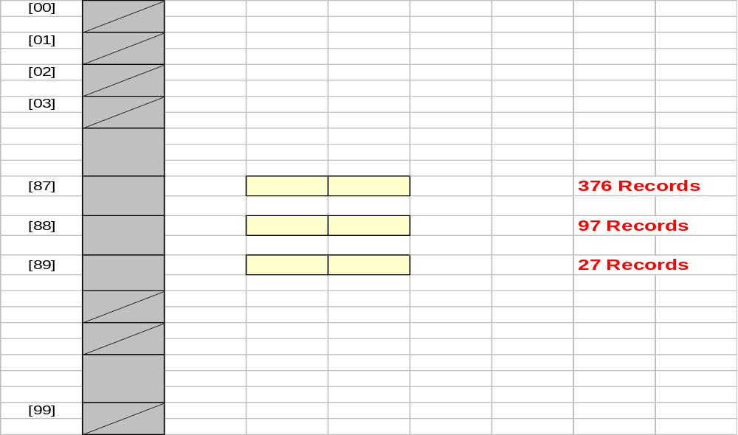
The Reality:
Why has this happened?
BSc in Software Development
Computer Science 1 2008/9

Slide 81
This has happened because:
  376 employees were hired in 1987
  97 employees were hired in 1988
  27 employees were hired in 1989
This makes up the total of 500 employees.
The actual average number of comparisons/search works out at 152 rather than the expected 3.
{(1+2+…+376) + (1+2+…+97) + (1+2+…+27)} / 500
{(376)(377)/2 + (97)(98)/2 + (27)(28)/2} / 500
{70876 + 4753 + 378} / 500
{76007} / 500 = 152.014 ~ 152 comparisons/search
BSc in Software Development
Computer Science 1 2008/9

Slide 82
The key was made up as follows:
  XXX X X
  3 digits 1 digit 2 digits
  Unique Number Dept. Number Year Hired
  (000-999) (0-9) (e.g. 89)
The last two digits of the employee’s 6 digit id is the year of employment.
Therefore this hash function is not going to give the required spread of keys throughout the index range, since the company was founded in 1987.
All the elements are crowded very disproportionately into a small subset of hash locations.
BSc in Software Development
Computer Science 1 2008/9

